Slide 1
Ultrasonic Level and
Radar Level Technologies
Ryan Dean
Outside Sales – Tampa Territory
Gilson Engineering Sales of Florida
Lithia, FL

Slide 2
Presenter Bio
Ryan Dean – Outside Sales
Gilson Engineering Sales of Florida – Tampa Territory
Based in Lithia, FL
BS Mechanical Engineering from University of Florida
Worked with Gilson Engineering for 11 Years
Held positions in Applications Engineering, Technical Support and Sales
Experience with Controls Instrumentation Including Level, Flow, Gas Detection, Wireless Telemetry, Temperature and Pressure products
Focus on the Water and Waste Water, Power, and Industrial Markets

Slide 3
Pdh Credit
This course is worth 1 pdh credit in FL or PA
Email me your PE # to receive a certificate
drd@gilsoneng.com

Slide 9

Non-contacting Technologies
Ultrasonics and Radar
Echo Ranging and Time of Flight Technology

Slide 11
Ultrasonic Level
Echo Ranging and Time of Flight
45.18 mS
52.65 mS
58.20 mS
0.00 mS
31.95 mS
41.99 mS
49.00 mS
38.55 mS
3.02 mS
35.22 mS
55.12 mS
16.07 mS
22.55 mS
19.19 mS
12.30 mS
15.10 mS
28.11 mS
9.80 mS
6.10 mS
25.77 mS
Sound travels at constant known velocity at a given temperature
Notes:
The speed of sound is known to be 1129 Ft/sec in air at 68F (20C)
So the first thing we do is send out a sound pulse, it reflects off of the material surface and then is received back at the transducer.
This is known as Time of Flight.
In this example, it takes 58.20 milli seconds for the round trip time.

Slide 12
Ultrasonic Level
Echo Ranging Calculation
Example: for a 58.2 millisecond time interval
DISTANCE = VELOCITY x TIME
65.62ft = 1127 ft/s x 58.2 mS
Divide by 2 to determine travel distance one way
65.70 ÷ 2 = 32.85 ft Distance
Speed of sound in air @ 68ºF is 1127 ft/s
Time between sound transmission and echo received
Notes:
So we know the round trip time it took from transmission to received echo
We know the velocity or speed that the sound wave is traveling at
Multiply them together and you get the total distance that the sound wave traveled
Since we only need to know ½ of that distance, we simply divide by 2 to actual distance from the face of the transducer to the material level.
Very simple right? Well there is allot more too it, but at it’s basic level, this is how ultrasonics works.

Slide 13
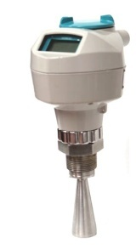
Radar Level
Echo Ranging and Time of Flight
22.55 nS
28.11 nS
3.02 nS
9.80 nS
0.00 nS
6.10 nS
65.12 nS
38.55 nS
45.18 nS
49.00 nS
52.65 nS
41.99 nS
12.30 nS
15.10 nS
16.07 nS
19.19 nS
25.77 nS
31.95 nS
35.22 nS
66.67 nS
Radar travels at constant known velocity of 9.84x10⁸ ft/s
The speed is independent of temperature in the vessel
Notes:
Now lets talk about how radar works.
The radar wave travels at a constant velocity, no matter the atmosphere or temperature in the vessel, and that is the speed of light.
9.84x10⁸ Feet per second or 300 million meters per second

Slide 14
Radar Level
Echo Ranging Calculation
Example: for a 66.67 nanosecond time interval
DISTANCE = VELOCITY x TIME
65.62 ft = 9.84x10⁸ ft/s x 66.67 nS
Divide by 2 to determine travel time one way
65.62 ÷ 2 = 32.81 ft Distance
Speed of light is 9.84x10⁸ ft/sec
Time between sound transmission and echo received
Notes:
So we know the round trip time it took from transmission to received echo.
We know the velocity or speed that the radar wave is traveling at (speed of light)
Multiply them together and you get the total distance that the radar wave traveled
Since we only need to know ½ of that distance, we simply divide by 2 to actual distance from the bottom of the horn to the material level.
Very simple right?

Slide 15
Time of Flight
The Calculation of Level
Level calculation from a distance measurement
Transmitter
Controller & Transducer
Radar
OR
OR
Known
distance
  = 30ft
Level reading example:
If the empty distance is 50ft and distance measured by the device is 30ft then material level calculated is:
50ft – 30ft = 20ft
50ft
20ft
3/27/2020
Notes:
So now that we know the distance from the level device to the material level, we can easily display the measurement with some simple math.
In this example, the customer wants to have the device display the actual material level.
We know the distance from the device to where zero is to occur, 50 ft.
We know that the distance from the level device to the material is 30 ft.
Simply subtract 30 ft from 50 ft and you have the material level of 20 ft.
This is how we can manipulate the level reading to show you what you need to see for your process.

Slide 16
Non-Contacting Level Operations
Level
Space
Distance
Volume
Differential
Open Channel Flow
Notes:
Based on the previous slide, most manufactures are able to display the reading in many different ways for you.
Level
Simple, the customer needs to know how much material is in the vessel.
This is the most widely used display method
Space
This is the amount of space is left in the vessel until you reach 100%
This is most often used when a customer has a “batching” system and they need to know how much room they have left in the vessel till it is full.
Distance
This the distance from the face of the transducer to the material level
This is like a tape measure.
Most often used by the I&E guys to verify the reading of the level device and not often used in normal production runs.
Volume
Just that, how many gallons are in the take for example
Differential
Some units have the ability to look at 2 different points independent of each other.
This can be a side by side tanks as above and the customer need to know what the difference in material level is
Another application for differential is across a bar screen to measure the up and down stream level to know when to activate the rake.
Open Channel Flow
Just that. Measuring the liquid flow of the influent or effluent flow of water through a primary device called a weir or flume.

Slide 17
Non-contacting Technologies
Ultrasonics and Radar
Digital Echo Processing
Notes:
Now we are going to start getting into the meat of how these 2 through air technologies work

Slide 18
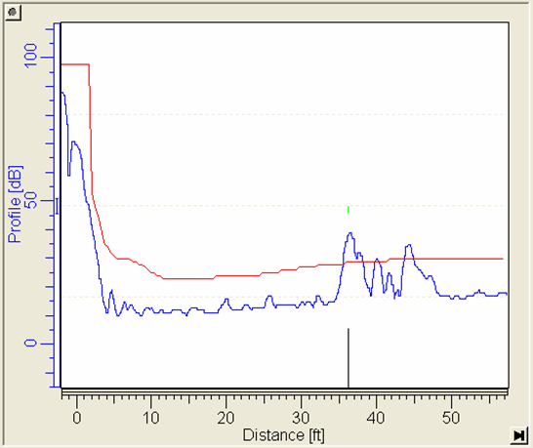
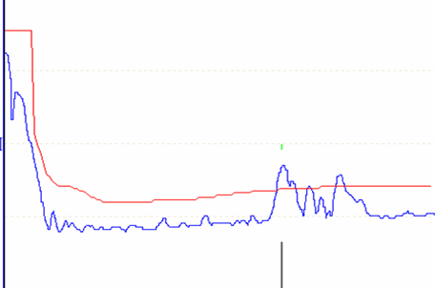
How it works
The anatomy of an echo profile
TVT – Time Varying Threshold
Echo Profile
Material Echo
(true echo)
Indirect Echoes
Echo Lock Window
Confidence Marker
Noise Floor
Notes:
Lets look at an echo profile.
What is it? Well, an echo profile is the graphical interpretation of the digital signal produced by Ultrasonic and Radar devices. The echo profile that you see in this example is generated and viewed in SIMATIC PDM. Think of this as a tank laying on it’s side. The left hand side would be the top of the tank and the right hand side would be the bottom of the tank.
The Echo profile is formed and is shown as a blue line.
Above the echo profile, shown as a red line is the TVT or Time Varying Threshold. This line is formed by the Sonic and Process Intelligence algorithms at a % of the height of the material echo. As the Material Echo increases and decreases in height (or strength) the TVT will increase or decrease respectively. One of the key aspects to the TVT line is that anything above the line is seen as a real echo and anything that is below the red line is ignored. More on TVT in the upcoming slides.
The front end of the echo profile (small waves) is referred to as the “Noise Floor”. A high noise floor is unfavorable and we ideally want to see it as flat as possible. Noise is typically caused by electrical interference in the application, or interference from signal reflections from obstructions in the tank.
Next we have the Material Echo otherwise referred to as the true echo. We know this is the true echo because the Sonic and Process Intelligence firmware has analyzed the Echo Profile and placed the confidence marker and echo lock window on the material echo. We would of course verify this visually during commissioning in a real application.
The Confidence marker identifies the level of confidence that the firmware has that it has selected the correct echo. Sonic and Process Intelligence analyzes every echo in the profile and scores them based on their Area, Largeness and whether or not they appear first in the profile. The Echo with the highest score or confidence wins.
The Echo lock window always appears, to mark the last correct echo selected.
The large echoes seen after the true echo are referred to as indirect echoes. They represent additional reflections from material surfaces and sometimes the indirect return path of the transmitted signal.

Slide 19




How it works – radar and ultrasonic echo profiles
1. The Pulse
2. The Return Signal
3. Form the Profile
4. Filtering
5. TVT
6. Echo Algorithms
7. Echo Selection
Notes:
A pulse is generated by the Product. For Radar it is a microwave pulse and for Ultrasonics it is a sound wave.
The pulse bounces or reflects back from the material level and back to the device where it is received and stored for analysis.
Remember that for either system to work if 1 and 2 do not happen, the system will not work
Example, had a customer that installed a new system much like you see here with a nozzle on top. They did a great job of installing the nozzle with the exception of cutting out the top of the tank. How well do you think the level system worked?
The device forms a profile.
The device then applies filtering algorithms to the profile which improves and enhances the signal.
The TVT line is formed above the noise floor and intersects any large echoes.
Echo selection algorithms are applied and assess each echo that crosses the TVT.
The echo with the greatest net confidence is selected and reported as the material level.
2 commonly used filters are the Spike Filter and the Narrow Echo Filter
Spikes are caused by electrical noise in applications from pumps, motors and drives. Their very thin profile characteristics are what allows our filtering to identify them and remove them.
Narrow echoes are false echoes that can be caused by any number of obstructions but more often than not are caused by pipes, bin weld seams, ladders and wires.

Slide 20
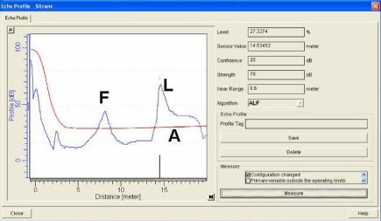
Echo Processing Algorithms
Echoes are evaluated by A, L, and F components (Area, Largest and First)
Mathematical Scores are assigned to each echo based on these 3 criteria
The highest score from the 3 criterion is selected for each echo
The echo with the largest net score is selected as the true echo
There are many variants of ALF, the most common being bLF (Best of Largest and First
  Only evaluates Largeness and Firstness – highest combined score wins
Notes:
All three algorithms are used on each measurement.
For each algorithm, a score or confidence is calculated for each echo, then the largest score of the 3 criteria is selected for each echo.
Finally, the echo with the highest score is deemed to be the true echo from the material surface.
Occasionally, one algorithm will give a low score to the true echo and a better score to a false echo, but the other algorithms will pull the total score of the true echo up, and push the total score of the false echo down.
For a given bin condition, a single algorithm may give higher echo confidence but, as bin conditions change, another algorithm may be required.
Using all three algorithms provides for reliable operation over time, however, a skilled technician can turn off one and produce better results than using all 3.

Slide 21
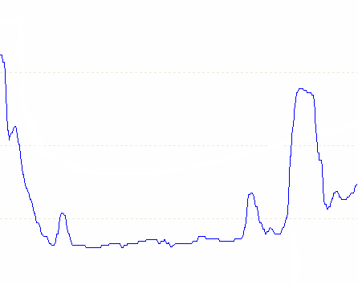
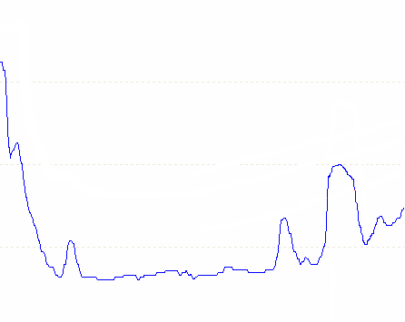
Time Varying Threshold
Changes in process conditions directly impact the signal strength
  Foam, Steam, Agitation, Dust
Notes:
The TVT line is a very important part of allowing a system to select the correct echo.
Remember that anything above the line is seen as a true echo to be evaluated as the material level and anything below the TVT line is ignored.
So what happens to the echo when process conditions change in the vessel such as Foam on the material surface or Steam in the atmosphere of the tank or agitation is added to the material or dust is present in the air space?
Lets take a look.

Slide 22
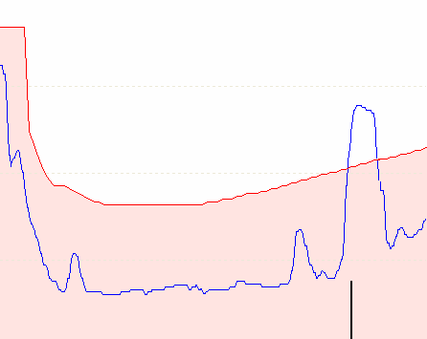
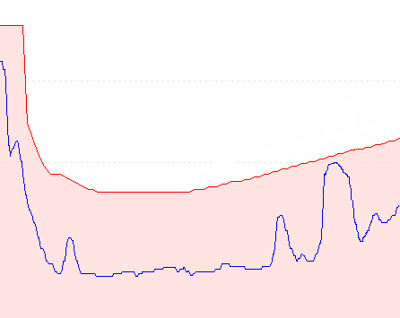
Time Varying Threshold
Changes in process conditions directly impact the signal strength
  Foam, Steam, Agitation, Dust
With a fixed threshold, as signal strength degrades, it is possible for the unit to lose sight of the material level entirely (Loss of Echo)
Notes:
So in this example, we have an application where one of the factors above is causing some issues with energy that is returned
As you can see in this example, as something is affecting the returned signal, and you have a static threshold level, as the returned signal falls below the threshold level, the system will lose the signal and go into it’s fault mode.

Slide 23
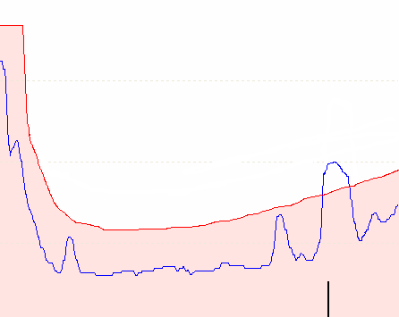
Time Varying Threshold
Changes in process conditions directly impact the signal strength
  Foam, Steam, Agitation, Dust
With a fixed threshold, as signal strength degrades, it is possible for the unit to lose sight of the material level entirely (Loss of Echo)
A system with Dynamic TVT, adjusts itself with each shot maintaining a lock on the material level as the signal strength decreases
Notes:
So by having this threshold level automatically adjust itself based on the height or amplitude of the returned echo (dynamic) the system will have a better chance of seeing the material echo as process conditions change.
So when you are evaluating your instrument providers, you should ask the question if their threshold level is static or dynamic. This could have an impact on how well the system will work in your applications.

Slide 24
Non-contacting Technologies
Ultrasonics and Radar
Transducer Frequencies and Beam Angle
Notes:
Now we get many questions on ultrasonic frequencies and beam angles.
Lets take some time to talk about these items

Slide 25
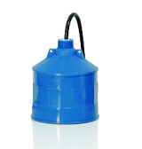
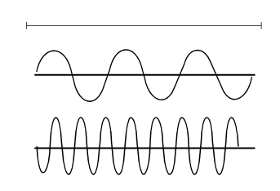
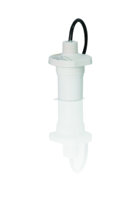
Ultrasonic Transducer Frequencies
Transducers operate at different frequencies depending upon the manufacturer and model
Long range transducers have a lower frequency
  Lower frequencies attenuate less than higher frequencies
  Better performance in dust, with build-up and on light density or light foaming materials
Short range transducers use a high frequency
  Higher frequencies have better accuracy because they have shorter wave lengths
  High frequency transducers have a shorter blanking distance
Time period (one msec)
Low Frequency
High Frequency
Notes:
I pretty much just read the text on this slide. Not much to add to it.
In this slide, I usually talk about how you can hear the bass from another car nearby and you cannot hear anything else.
Bass or low frequencies carry farther and therefore we hear the bass from the car stereo
The high frequencies do not carry as far and that is why we cannot hear them from the car stereo.

Slide 26


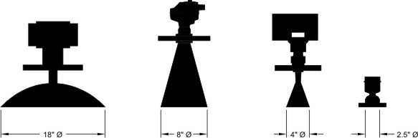
Radar Beam Angle
Increased the frequency, yields:
Increased precision
Smaller antennas
Tighter beam angle (less view of obstructions)
Easier to install
Better for solids (dust and fine granules)
Potential negative effect of process conditions
  Build up
  Very High Humidity
  Turbulence
6 to 25 GHz best suited to liquids applications
25 to 78 GHz best suited to solids applications
6GHz
25GHz
78GHz
12º 8º 4º
Notes:
Operating at 78 GHz frequency means that the SITRANS LR560 has a very narrow beam width of only 4°.
This is important because it means that the transmitter can be installed practically anywhere on the top of the silo.
Its small size means that it can usually be installed on any existing nozzle or tank opening.
The traditional problems of noisy signals due to the standpipe/nozzle are now eliminated.
Even the cone area can be measured effectively because the narrow beam can be aimed there.
Wider beam angles typical of lower frequency radar can have difficulty measuring the cone area of the silo.
They tend to see the sides of the silo and miss the true level reading in the cone area.
For comparison: a 25 GHz radar transmitter would need a large dish antenna to be to obtain a 4º beam.
Guided wave radar can see the material in the cone area but it must be positioned correctly for accurate measurements.

Slide 27

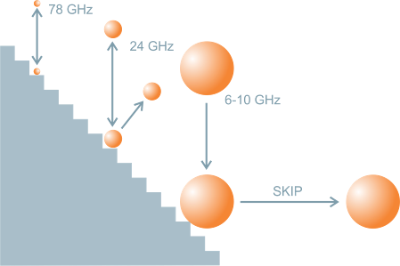
Radar Beam Angle
  Typical Frequencies:
    6GHz
    25GHz
    78GHz
  SKIP & Beam angle
25 GHz
Guided
wave radar
Smaller Antennae
Easier installation
78 GHz
12°
Higher frequency
Narrower beam
4
°
Higher frequency
Less skip
Notes:
In this case, we are trying to show an example of how smaller beam angles can help with readings in solids applications.
There are not many solids applications in the Water market other than maybe a lime silo, but this is still good information to know.
So in the example above, we have 3 different frequencies we are comparing.
The 6-10 GHz would be like a beach ball and trying to get it to bounce straight back from a set of stairs. If is very difficult to get that beach ball to bounce straight back. It will want to skip out and we do not get much energy back
The 24 GHz signal is somewhat small but imagine it as the size of a basketball. We will have a better chance of getting the signal back but still will have some issue with energy “skipping” away
Now at 78 GHz, we are talking about a golf ball size or ping pong ball size echo. We will have a much better chance of getting the energy back and locking in and measuring the proper level.
So in this case, if you are measuring solids, the higher the frequency, the better.

Slide 28
Non-contacting Technologies
Ultrasonics and Radar
Installation Considerations

Slide 29
Installation Considerations – Liquids
Ladder Tank support braces
2
3
4
1
Which location is the best location
To install either an Ultrasonic Level
Device or a Radar Level Device?
1
2
3
4
Fill Pipe
Notes:
In this slide, you need to open up to the audience and get them involved.
Explain that we have a vessel here that has a flat bottom and a dish shaped top.
Which is the correct location to mount your level device? Who says 1. Who Says 2, etc..
Once you have everyone’s selection, go to the next set of slides.

Slide 30
Installation Considerations – Liquids
  Too close to side wall – interference from ladder rungs and support braces
2
3
4
1
Fill Pipe
Notes:
Not good because of the obstructions.
This location can be used is no other available but you may have issues with the overall performance.

Slide 31
Installation Considerations – Liquids
  Too close to side wall – interference from ladder rungs and support braces
  Correct installation – 1/3 the distance from the side wall, no obstructions
2
3
4
1
Fill Pipe
Notes:
Yep, this one is the right location.
If you have give aways, you can hand out to the ones that got it right.
The typical installation is 1/3 the distance from the side wall and you get the best return with no interference.

Slide 32
Installation Considerations – Liquids
  Too close to side wall – interference from ladder rungs and support braces
  Correct installation – 1/3 the distance from the side wall, no obstructions
  Center of a parabolic tank – problems with secondary echoes
2
3
4
1
Fill Pipe
-3dB (50%)
Notes:
This in NOT the ideal location.
In this application we have a dish shaped top.
I usually ask the customers who has satellite for their TV service.?
That is the shape of the antenna that you get your signal through?
What does that dish shape do to the satellite signal? It amplifies and focuses the signal to the actual receiver.
Go to the next slide to finish this part of the discussion.

Slide 33
Installation Considerations – Liquids
  Too close to side wall – interference from ladder rungs and support braces
  Correct installation – 1/3 the distance from the side wall, no obstructions
  Center of a parabolic tank – problems with secondary echoes
2
3
4
1
Fill Pipe
Notes:
With an amplified or focused signal from the shape of the tank top, we can get secondary echoes, that are as large and in some cases, larger than the true material echo and can cause readings that appear to show a level that is less than the actual level and you can run the chance of overfilling the vessel and spilling material or damaging equipment.

Slide 34
Installation Considerations – Liquids
  Too close to side wall – interference from ladder rungs and support braces
  Correct installation – 1/3 the distance from the side wall, no obstructions
  Center of a parabolic tank – problems with secondary echoes
  Obstruction from fill stream
2
3
4
1
Fill Pipe
Notes:
4 is not optimal because of the fill pipe. In some cases, we can filter out the obstruction if it is not too large.

Slide 35
Installation Considerations – Liquids
  All material levels should be considered when selecting mounting location
  Obstructions must be exposed before Auto False Echo Suppression can be performed
2
3
4
1
Fill Pipe

Slide 36
Installation Considerations – Liquids
  The sound path should be perpendicular to the monitored surface
    Flat for liquids and slurries
Fill Pipe
Notes:
Make sure on liquids that the transducer is pointing straight down.

Slide 37
Installation Considerations – Solids
  The sound path should be perpendicular to the monitored surface
    Flat for liquids and slurries
    Matching the angle of repose for solids
  For Ultrasonics, avoid proximity to high voltage or current wiring, high voltage or current contacts, and to variable frequency motor speed controllers
Nozzle considerations
  Most horn antennas should extend 0.4” below nozzle
  Measure nozzle from inside

Slide 38
Mounting Considerations
Nozzle considerations
  Ensure nozzle does not interfere with beam path

Slide 39
Mounting Considerations
Nozzle considerations
  Ensure nozzle does not interfere with beam path
  Use horn extensions when required

Slide 40
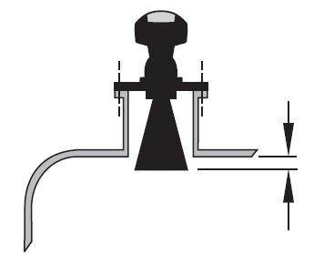
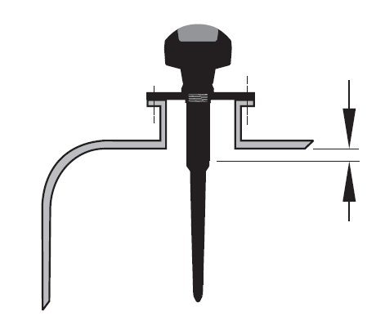
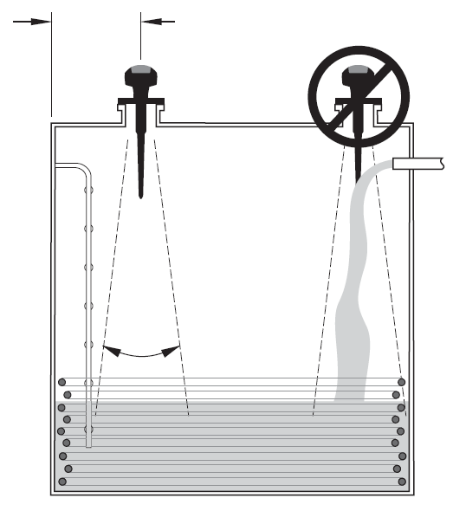
Mounting Considerations
6GHz
Min. clearance: 10 mm (0.4”)
Beam angle:
100 mm (4”) rod = 28°
150 mm (6”) rod = 28°
200 mm (8”) rod = 28°
4” horn = 29°
6” horn = 20°
8” horn = 17°
Notes:
Installation details are important for any field device, but especially true for a non contact level transmitter.
Employment of higher frequency devices has made this a little easier as the smaller antenna design allows the unit to be installed on more “standard” nozzle sizes instead of >4”.
In earlier stages of the Radar transmitter lifespan, the transmitter was often made to fit the vessel and Rod antennas installed because they fit through the process connection.
This was often a big mistake and caused many issues once installed.
The end of the horn antenna should protrude from the end of the standoff/nozze to ensure the signal doesn't intersect the end of this nozzle (otherwise noise is introduced)
Rod antenna are very sensitive to the mounting nozzle and it is critical that the shield (non active part of the antenna) is slightly longer than the standoff/nozzle to prevent a noisy signal.
For by-pass tubes or other applications where there is a fixed obstruction within the measuring zone (slots, holes, baffle plates, etc.) it is important to orient the radar device so that the E-field (identified in the manual) towards the fixed interference object. This will minimize the interference from this object.
For solids applications it's important to aim the sensor towards the angle of repose to ensure optimum reflection when angles of repose are present.

Slide 41
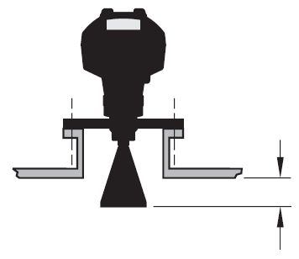
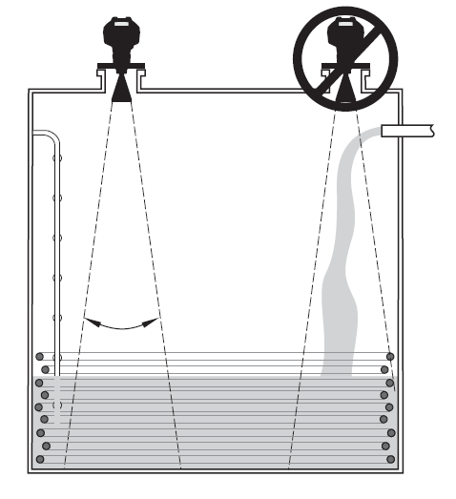
Mounting Considerations
25GHz
Min. clearance: 10 mm (0.4”)
Beam angle:
1.5” horn = 19°
2” horn = 15°
3” horn = 10°
4” horn = 8°
Notes:
Installation details are important for any field device, but especially true for a non contact level transmitter.
Employment of higher frequency devices has made this a little easier as the smaller antenna design allows the unit to be installed on more “standard” nozzle sizes instead of >4”.
In earlier stages of the Radar transmitter lifespan, the transmitter was often made to fit the vessel and Rod antennas installed because they fit through the process connection.
This was often a big mistake and caused many issues once installed.
The end of the horn antenna should protrude from the end of the standoff/nozze to ensure the signal doesn't intersect the end of this nozzle (otherwise noise is introduced)
Rod antenna are very sensitive to the mounting nozzle and it is critical that the shield (non active part of the antenna) is slightly longer than the standoff/nozzle to prevent a noisy signal.
For by-pass tubes or other applications where there is a fixed obstruction within the measuring zone (slots, holes, baffle plates, etc.) it is important to orient the radar device so that the E-field (identified in the manual) towards the fixed interference object. This will minimize the interference from this object.
For solids applications it's important to aim the sensor towards the angle of repose to ensure optimum reflection when angles of repose are present.

Slide 42
Mounting Considerations
Nozzle considerations
  Rod antenna shield should extend 0.4” below nozzle
  Measure nozzle from inside
Antenna Shield
28°
Notes:
Slide is pretty self explanatory.
This slide shows the actual transmission (polar) pattern of a radar unit with an antenna. As you can see, there is energy that begins to emit at the transition point of the antenna.
This is why you have to have that straight run at the top extended below the nozzle.
We have extension pieces if needed.

Slide 43
Mounting Considerations
Nozzle considerations
  Most horn antennas should extend 0.4” below nozzle
  Measure nozzle from inside
Antenna Horn
0.4” (10mm)
8°
Notes:
Note that the horn style radar units have a different transmission (polar) pattern. Tear drop
Again, the horn must extend past the nozzle.

Slide 44
Non-contacting Technologies
Ultrasonics and Radar
Application Challenges

Slide 45
Speed of Sound
Speed of Sound vs. Temperature
Speed of sound varies with temperature and must be compensated for
~0.17% error per meter per °C
Transducers or external temperature sensors measure temperature and compensate for changes in speed of sound
380
360
340
METRES PER SECOND
320
300
0
5
10
15
20
25
30
35
40
45
50
55
60
Attenuation of sound in different atmospheres
Speed of sound varies with atmospheres other than air
Sound does not propagate in some atmospheres (e.g. carbon dioxide, vacuum) and therefore alternative technologies are required.
Most ultrasonics can be calibrated in many atmospheres other than air
DEGREES CELSIUS
Notes:
The speed of sound will vary as the temperature in the application changes.
If the temperature changes, the speed of sound will change as well in a linear fashion.
Most manufacturers now include temperature sensors in the transducers to automatically change the speed of sound.
There are external temperature sensors as well that have a faster response to the change in temperature that can help with the overall accuracy of the level reading especially in Open Channel Flow applications.
The speed of sound is affected by the medium in which it is traveling.
Different atmospheres have a different speed of sound as shown by the chart in the lower right hand corner.
As long as the atmosphere is constant, Ultrasonics will work fine in atmospheres other than air. It is in those applications where the air space vapor concentration changes that Ultrasonic Level will struggle.
In this case, you will want to go with a radar solution as a microware or radar signal is not affected by the atmosphere.

Slide 46
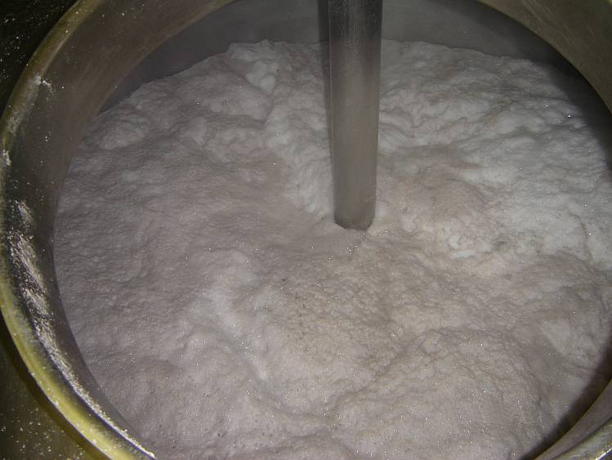
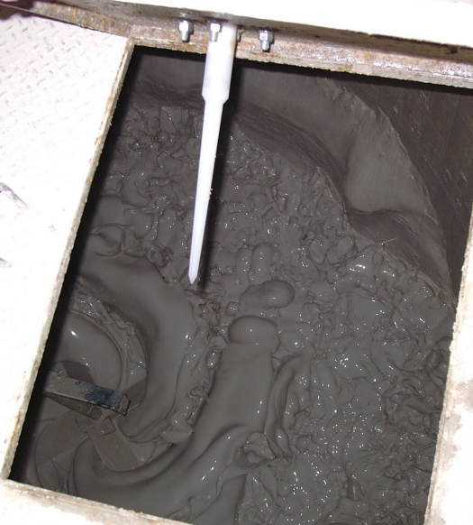
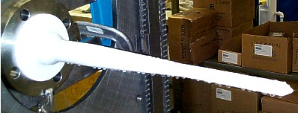
Changing Process Conditions
Foam
Agitation
Condensation
Notes:
Comments:
Process data:
Changing process conditions can play a big part in the overall success of the level solution.
Foam – IS NOT OUR FRIEND. We will talk more about that in the next slide
Condensation
Can really hurt both ultrasonics and radar level devices.
Some ultrasonic transducers have an active face that can help to keep the condensation from building up on the face.
Some Siemens transducers actuall have a concave face and drip ring built-in to help.
If the atmosphere is much like a light rain storm, there is very little you can do. Here are a couple of tips that may help
Use Rain-X on the face of the transducer as long as the Rain-X will not contaminate the process.
You can put a slight tilt on the transducer, about 1 degree, to help the water to bead off to one side.
If on a nozzle, you can heat trace the nozzle to help reduce the condensation.
You can increase the number of shots that the unit takes, but this will slow down the overall response time as we discussed earlier.
For Radar,
Horn antennas have a harder time than rod antennas.
As you can see on the rod antenna in the picture above, the shape of the antenna does not allow for much build-up and it drips off easily.
Horn antennas have an exposed emitter inside and if the condensation gets up to the emitter to the point that the device can have a hard time getting the transmit pulse out.
If you have hevy condensation, you will want to go with a Rod style antenna on your radar device.

Slide 47






What about foam and how it affects Ultrasonics and Radar?
Low Frequency
6 GHz
High Frequency
25 GHz
LIGHT
DENSE
MEDIUM
FOAM
Notes:
As I mentioned in the last slide, Foam is not our friend. It will cause all kinds of problems with through-air technology depending on the type of foam that is present.
There are 3 basic types of foam that we have to deal with. Light, Medium and Dense. Lets take a look at how each affect the different technologies.
We have a Low Frequency Radar Unit that operates at 6 GHz, an ultrasonic Level Device operating about 44 KHz and then a high frequency radar operating at 25 GHz.
Dense Foam
With a dense foam, you typically have a hard surface or a surface with mass that will give a reflection off of the top surface.
You can pretty much use any of these devices in this application.
You will have some signal loss from absorption by the foam from all 3 devices
Light Foam:
25 GHz Radar will have a problem with light foam. There is allot of absorption of the signal by the foam and we do not get much signal back
Ultrasonic may or may not work in light foam. It all depends on the amount of water that is contained in the foam. We usually are able to get a signal but it will have reduced signal strength and may not give you the best performance in the application.
Low Frequency or 6GHz radar actually gives a good return signal. If you have an issue with a light foam, like that from the discharge of a laundry mat for example, I would go with 65 GHz radar.
Medium Foam:
Well, lets see how we do on medium foam with these technologies.
as you can see from the slide, there really is not a good solution in through air technology.
With a medium foam, there is too much absorption of the signal to get anything back,
In this case, I would go with a submergence pressure transmitter.

Slide 48
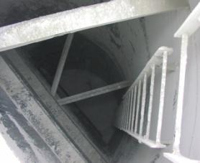
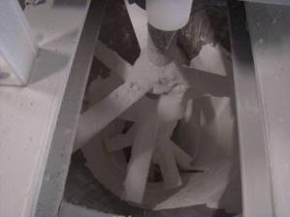
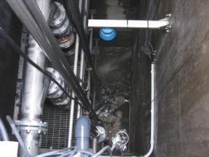
Installation Challenges – Obstructions
Split silo with supports
Agitator Blades
Narrow Wetwell
Notes:
So now lets take a look at how we can deal with obstacles.
I usually say something smart, like because you know there are never anything inside the bin except free space for instruments to shoot down and then talk about supports, or agitator or how customers cram as much “stuff” into their wet wells that will cause false echoes that we have to deal with.

Slide 49


False Echo Suppression
Not available on all Mfg equipment
④
1. The Pulse
2. The Object Return Signal
Determine distance to material
Subtract ~0.3 meters or 1 foot
Enter this value as the “Suppression Range”
Perform a “Learn”
3. The Material Return Signal
Typical obstructions:
  Pipes
  Weld seams
  Ladders
  Agitators
  Support structure
  Beams
  Wires
4. Form the Echo Profile
①
5. Apply Filtering
③
6. TVT Profile
②
7. Apply Echo Algorithms
8. Echo Selection
9. Run Auto False Echo Suppression
10. Echo Selection
Notes:
Let’s look at the Auto False Echo Suppression feature built into several of our products including the MultiRanger100/200, the HydroRanger, Probe LU and our entire Radar offering.
We can see from the example that the unit is selecting the filling pipe as the material level because there is a strong return echo from it.
By using the Auto False Echo Suppression function, we can learn the TVT around the pipe so that the unit will instead select the further echo, which represents the material surface.
Auto False Echo Suppression function can be accessed either locally at the unit using the hand programmer or in SIMATIC PDM.
From this point forward the TVT will always shape around the pipe. Even if the signal from the pipe increases over time, say from material building up on it, thus increasing it’s size, our dynamic TVT will continue to shape around it.

Slide 50
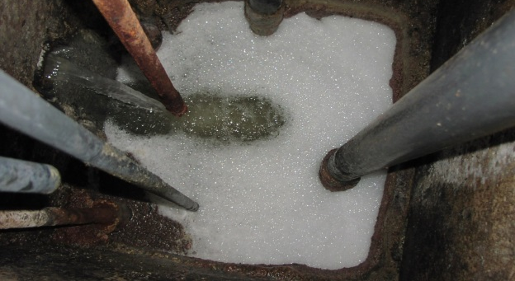
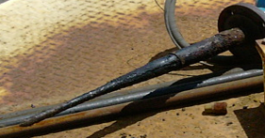

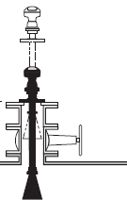
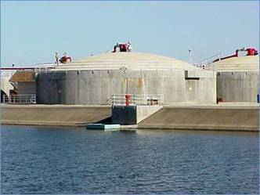
Application Challenges
Foam, Build-up and Turbulence
Foam Deposit Turbulence
6GHz has a longer wavelength than 25GHz
penetrates foam easier
deposit has lesser effect
better reflection from turbulent surfaces
Notes:
For ‘dirty’ applications with build-up, foam or slurries or agitation, 6GHz still has some big advantages but one must be careful with installation.
Cautionary notes:
6GHz has a wide beam (typically 28 degrees for rod antenna)
Wide beam will intersect tank wall and resultant echo mixes with direct path, leading to inaccuracy.
Typical accuracy with 6GHz in the tank is 25mm to 50mm.
6GHz is quite sensitive to mounting "imperfections". It is critical to ensure the shield of the antenna is longer than the standoff nozzle.
Do not mount 6GHz radar in the center of the tank.
Note the long antenna, therefore the short measurement capability is not as good as the LR250
Antenna options such as Sliding Waveguide are available on Low Frequency and also Bent Waveguides.

Slide 51
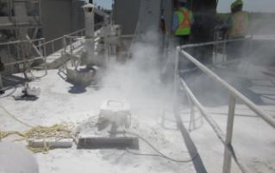
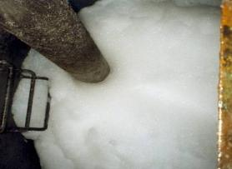
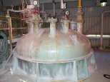
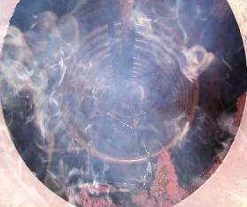
Application Challenges
Things to Remember
High Temperature (>100°C)
Most Vapors
Severe Dust
Light density Foam
Absolute Vacuum
These are Radar applications

Slide 52
Non-contacting Technologies
Ultrasonics and Radar
Advantages and Disadvantages of Ultrasonics and non-contacting Radar

Slide 53
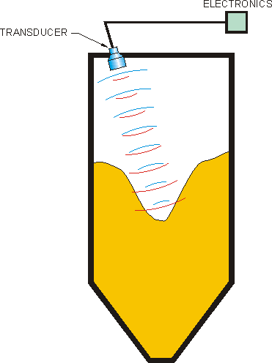
Advantages and Disadvantages of
Ultrasonic Level
Advantage
    Non-contact
    Well proven
    Liquids or slurries
    Self cleaning transducer face from many manufacturers
    Able to detect submergence (with installed shield)
    Control capabilities (pumping & alarms)
    Remote display
    Potted / Robust transducer for vibration and shock
      No electronics in vessel
Disadvantage
    Sensitive to vapor changes in medium
    Can be sensitive to foam
    Limited pressure and temperature range
Liquids
Slurry
Solid
Notes:
Ultrasonic technology is still the most common of non-contacting level measurement in use today. A sonic pulse is transmitted towards a material surface. The reflected signal is received and the time of flight of the pulse is measured. Distance is i proportional to the time of flight. Level can be inferred from the distance measurement. Ultrasonics can also provide reliable point level measurement with the advantage of “two switches in one”.
Recent advances in radar technology have displaced some of the traditional customers.

Slide 54
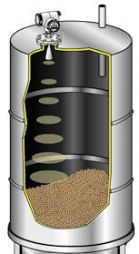
Advantages and Disadvantages of
Through Air Radar
Advantage
    Non-contacting
    Insensitive to vapours and dust
    Unaffected by temperature and pressure
    Process connection flexibility
    Solids, liquids or slurries
    Can penetrate certain plastic tanks
Disadvantage
    Can be sensitive to foam
    Can be sensitive to very heavy condensate
    Limited selection for open vessels
      See FCC guidelines
Pulse
Liquids
Slurry
Solid
Notes:
Recent advances in high frequency technology have allowed the use of radar technology for cost effective level measurement. There are numerous subcategories within this technology based on frequency, spectrum and accuracies. Radar technology is presently being used for both inventory management and process measurement.

Slide 68

Ultrasonic Level and
Through Air Radar Level
Questions?
Notes:
68

Slide 69
Contact Information
Ryan Dean
Outside Sales
Gilson Engineering Sales of Florida
+1 (954) 644-9602
drd@gilsoneng.com

